Slide 1
Lesson 8 – Homework review

Slide 2
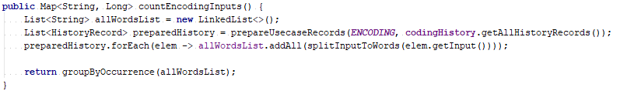
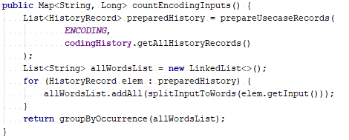
Do not do side effects in lambda

Slide 3
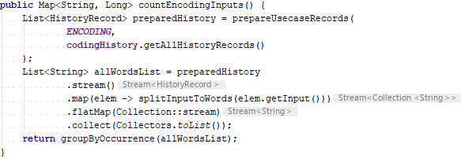
Do not do side effects in lambda

Slide 4
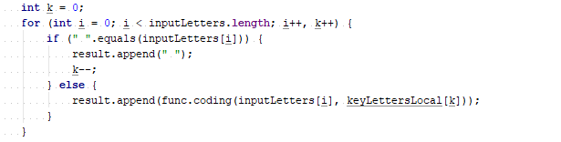
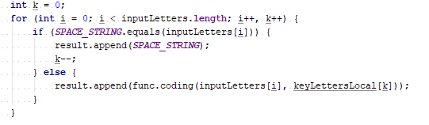
Do not use magic strings/numbers/etc

Slide 5


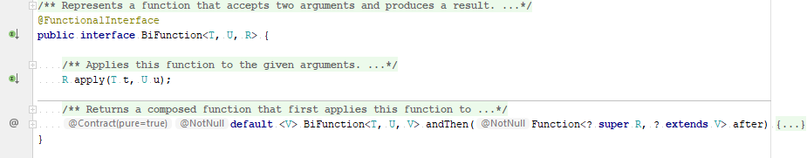
Use classes provided by JDK (if possible/make sense)
Notes:
In this example custom functional interface does not required:
Functional interface already exists in JDK
Custom interface used only inside one class in private methods and name of interface or methods do not provide some additional info or context for another developers
Implementation is not optimal: it always used with same generic types (that’s why they can be remove, additionally boxing/unboxing of char will be avoided)

Slide 6
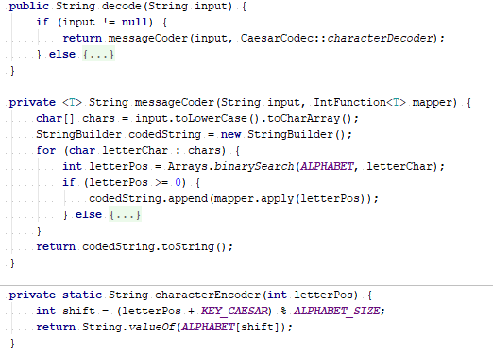
Do not use <T> where single type possible

Slide 7
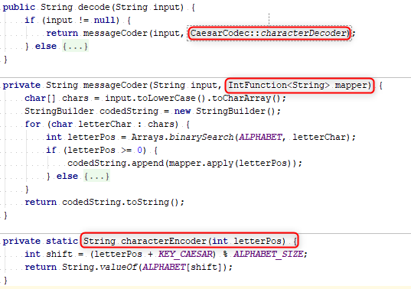
Do not use <T> where single type possible

Slide 8
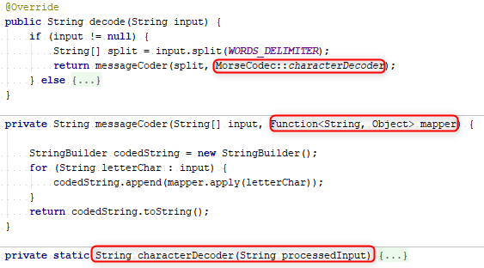
Do not use Object as generic param where concrete type possible

Slide 9
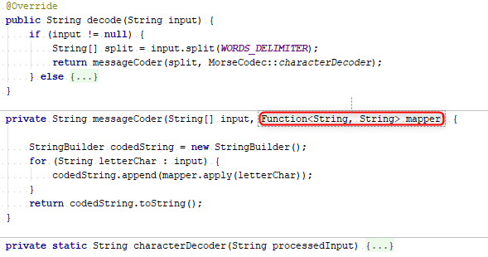
Do not use Object as generic param where concrete type possible

Slide 10

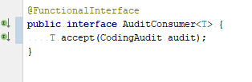
Use generics in [functional] interfaces

Slide 11
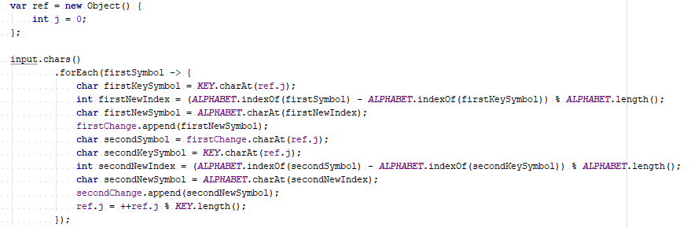
Do not create HUGE lambdas

Slide 12
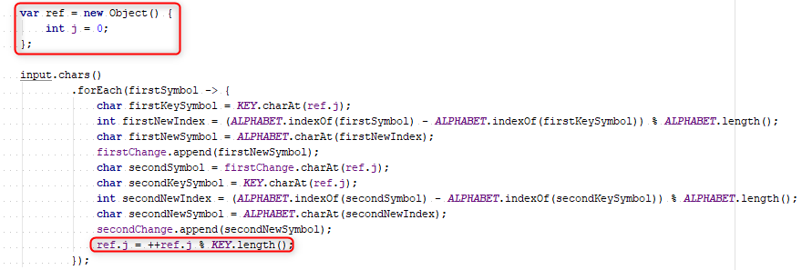
Do not do side effects in lambda

Slide 13
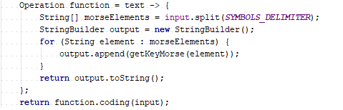
Do not create lambda just to use in next line of code

Slide 14
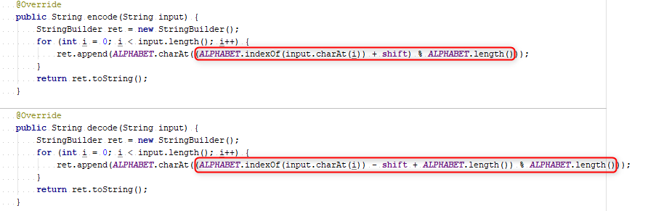
Use lambdas only where required (not everywhere)

Slide 15
Apply recommendations from personal feedbacks before starting next homework

